Slide 1

SKN Sinhgad College of Engineering,
Korti, Pandharpur
Presentation On Project
Title of Project: “Implementation of EHR System Through Hyperledger Fabric”.
Name Of Department:- Computer Science and Engineering
Class :-BE BTech 2022-23.

Slide 2
Title :
Implementation of EHR System Through Hyperledger Fabric
Presented By
Mr. Ajit Patil
Project Guide:
Asst. Prof. N. M. Sawant

Slide 3
Problem Statement
Electronic Health Records (EHRs) that hold various personal data has been the target of various cyber-attacks.
Maintain privacy of client personal record
Records are maintain by central authority i.e. no ownership.
No ownership means data can be handled or might be sold without patient permissions.

Slide 4
Objectives
To study and implement Hyperledger Fabric Framework.
Develop a Block Chain - based electronic health record system
Allow secure and efficient sharing of health records

Slide 5
Types Of Health Records :
PHR: A personal health record, or PHR, is an electronic application through which patients can maintain and manage their health information
EMR: An electronic medical record (EMR) is a collection of medical history, diagnoses, medications, immunization dates, allergies, lab results and doctor’s notes within one health care organization.
EHR: An electronic health record (EHR) is a digital version of a patient’s paper chart. EHRs are real-time, patient-centered records that make information available instantly and securely to authorized users.

Slide 6
Why Blockchain is suitable for EHR ?
Blockchain can transform the way a patient’s electronic health records are stored and shared.
It can provide a safer, more transparent, and traceable underpinning system for health information exchange.
The technology has the potential to connect multiple data management systems working in silos and provide what could be a connected and interoperable electronic health record system.

Slide 7
Blockchain :
What is a Blockchain?
A blockchain is essentially a digital ledger of transactions that is duplicated and distributed across the entire network of computer systems.
Each block in the chain contains a number of transactions, and every time a new transaction occurs on the blockchain, a record of that transaction is added to every participant’s ledger.
There are Four types of Blockchains :
Public (Permissionless).
Private (Permissioned).
Consortium(Permissioned).
Hybrid(Permission & permissionless).

Slide 8
Hyperledger Fabric Framework
Private Block chain
Developed by multiple companies, including IBM, Intel, and SAP
Developed on Linux Operating
Developed in go language .
Smart Contract Support node , go , typescript , java

Slide 9
Methodology
1.Use case definition
Define the specific use case for the EHR system
2. Database Selection
1.Leveldb : I. key-value store database
II. default database for Hyperledger Fabric
III. fast and efficient
IV. does not provide advanced querying capabilities
2.Couchdb : I. document-oriented NoSQL database
II. stores data as JSON documents
III. does not provide advanced querying capabilities
IV. provide advanced querying capabilities
3.Hyperledger Fabric installation
Install particular version of hyperledger fabric that match with requirement and its matching version of nodejs and npm

Slide 10
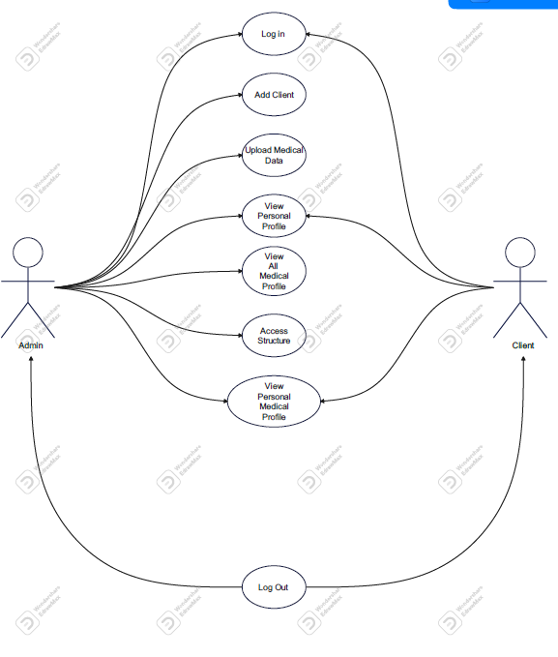
Use case Diagram

Slide 11
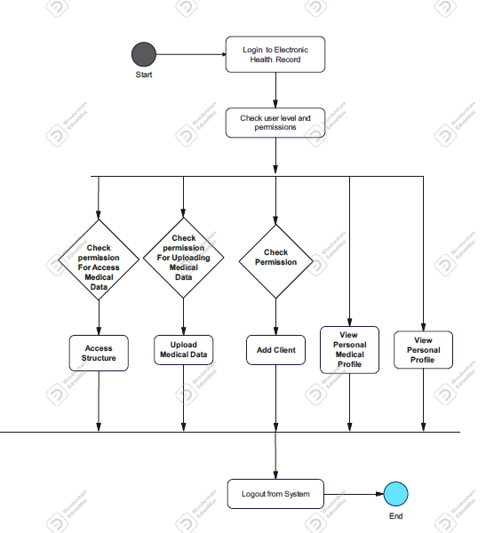
Activity Diagram

Slide 12
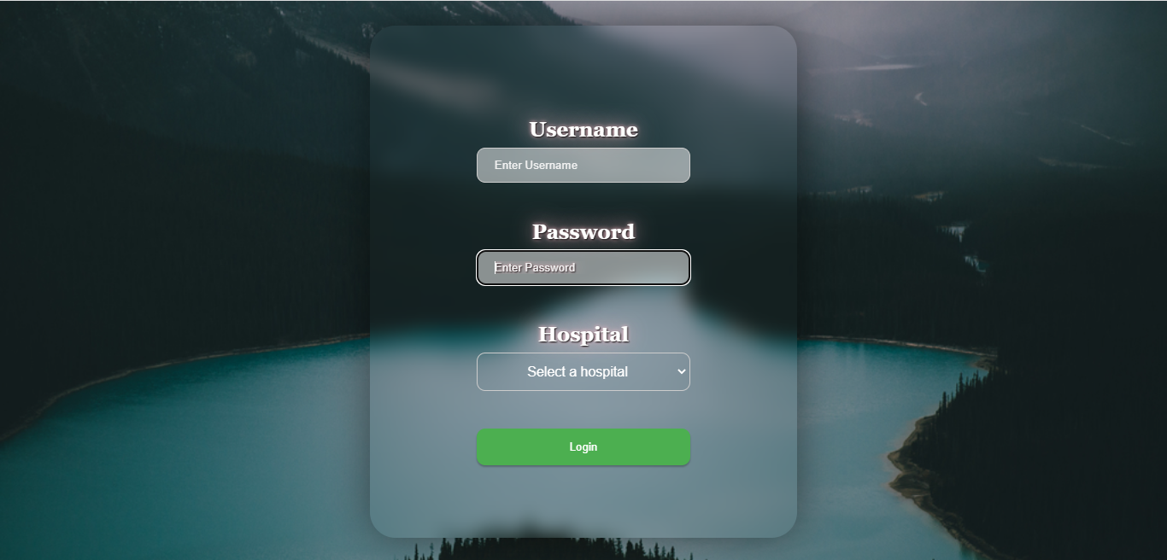

Slide 13
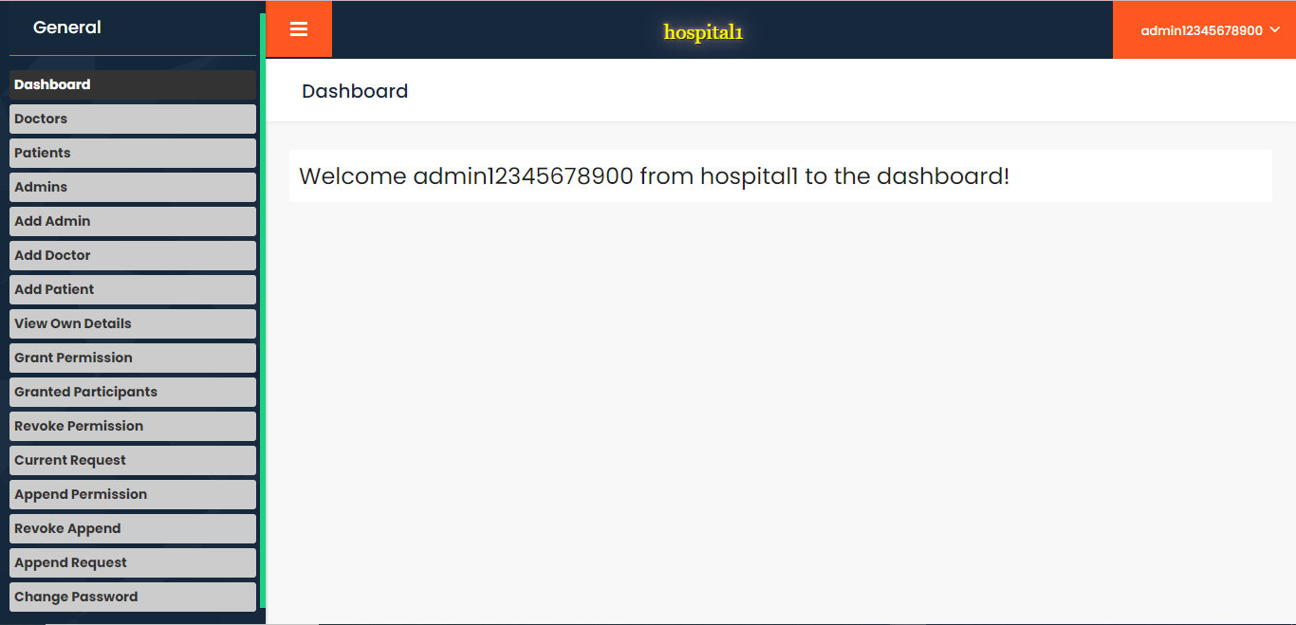

Slide 14
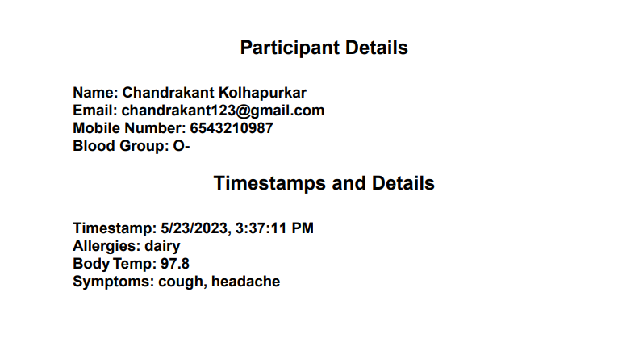

Slide 15
Results
Three originations with three participants :
Admin :
1.Add another admin , patient , doctor.
2.See name and mobile number of doctor , patient
Doctor :
1.See the details of patient that give consent
Patient :
1.Grant Access to admin , doctor

Slide 16
Conclusion:
Developed a secure and efficient electronic health record system
potential to revolutionize the healthcare industry

Slide 17


